Slide 1
Data and Computer Communications
Chapter 2 – Protocol Architecture, TCP/IP, and Internet-Based Applications
Eighth Edition
by William Stallings
Lecture slides by Lawrie Brown
Notes:
Lecture slides prepared by Dr Lawrie Brown (UNSW@ADFA) for “Data and Computer Communications”, 8/e, by William Stallings, Chapter 2 “Protocol Architecture, TCP/IP, and Internet-Based Applications”.

Slide 2
Protocol Architecture, TCP/IP, and Internet-Based Applications
To destroy communication completely, there must be no rules in common between transmitter and receiver—neither of alphabet nor of syntax —On Human Communication, Colin Cherry
Notes:
This quote from the start of Stallings DCC8e Ch2 illustrates a key issue which this chapter explores, providing a context for the detailed material in the following parts of the text.

Slide 3
Need For Protocol Architecture
data exchange can involve complex procedures, cf. file transfer example
better if task broken into subtasks
implemented separately in layers in stack
  each layer provides functions needed to perform comms for layers above
  using functions provided by layers below
peer layers communicate with a protocol
Notes:
When computers, terminals, and/or other data processing devices exchange data, the procedures involved can be quite complex. eg. file transfer. There must be a data path between the two computers. But also need:
Source to activate communications Path or inform network of destination
Source must check destination is prepared to receive
File transfer application on source must check destination file management system will accept and store file for his user
May need file format translation
Instead of implementing the complex logic for this as a single module, the task is broken up into subtasks, implemented separately. In a protocol architecture, the modules are arranged in a vertical stack, each layer in the stack performs a related subset of the functions. It relies on the next lower layer to perform more primitive functions. It provides services to the next higher layer. The peer layers communicate using a set of rules or conventions known as a protocol.

Slide 4
Key Elements of a Protocol
syntax (how it is written) -> data format
semantics (what it means) -> control info & error handling
timing -> speed matching & sequencing
Notes:
Communication is achieved by having the corresponding, or peer, layers in two systems communicate. The peer layers communicate by means of formatted blocks of data that obey a set of rules or conventions known as a protocol. The key features of a protocol are:
• Syntax: Concerns the format of the data blocks
• Semantics: Includes control information for coordination and error handling
• Timing: Includes speed matching and sequencing

Slide 5
TCP/IP Protocol Architecture
developed by US Defense Advanced Research Project Agency (DARPA)
for ARPANET packet switched network (1969)
used by the global Internet
protocol suite comprises a large collection of standardized protocols
Notes:
The TCP/IP protocol architecture is a result of protocol research and development conducted on the experimental packet-switched network, ARPANET, funded by the Defense Advanced Research Projects Agency (DARPA), and is generally referred to as the TCP/IP protocol suite. This protocol suite consists of a large collection of protocols that have been issued as Internet standards by the Internet Activities Board (IAB).

Slide 6
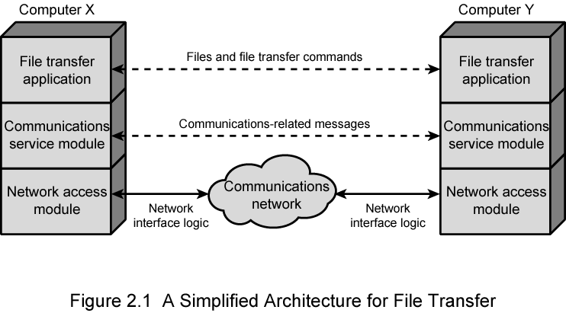
Simplified Network Architecture
Notes:
In general terms, communications can be said to involve three agents: applications (eg. file transfer), computers (eg. PCs & servers), and networks. These applications, and others, execute on computers that can often support multiple simultaneous applications. Computers are connected to networks, and the data to be exchanged are transferred by the network from one computer to another. Thus, data transfer involves first getting the data to the computer in which the application resides and then getting the data to the intended application within the computer. Can think of partitioning these tasks into 3 layers as shown.

Slide 7
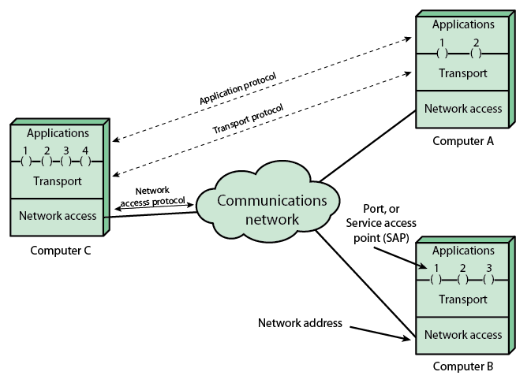
Protocol Architecture and Networks
Notes:
Stallings DCC9e Figure 2.1 indicates that modules at the same level (peers) on different computers communicate with each other by means of a protocol. An application entity (e.g., a file transfer application) in one computer communicates with an application in another computer via an application-level protocol (e.g., the File Transfer Protocol). The interchange is not direct (indicated by the dashed line) but is mediated by a transport protocol that handles many of the details of transferring data between two computers. The transport protocol is also not direct, but relies on a network-level protocol to achieve network access and to route data through the network to the destination system. At each level, the cooperating peer entities focus on what they need to communicate to each other.

Slide 8
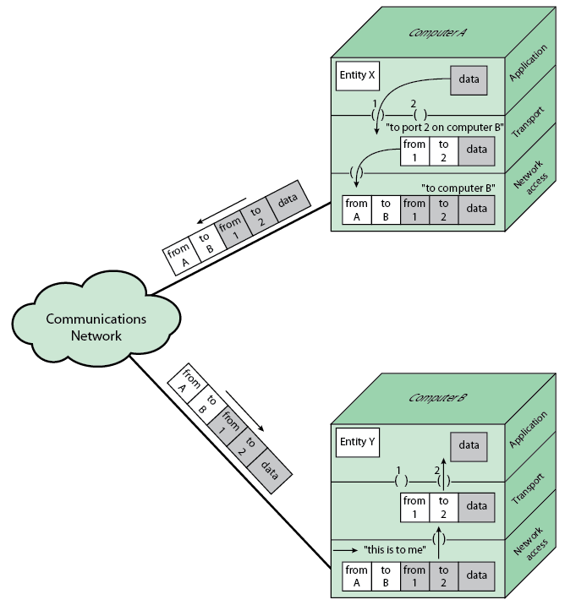
Protocols in a Simplified Architecture
Notes:
Let us trace a simple operation. Suppose that an application, associated with port 1 at computer A, wishes to send a message to another application, associated with port 2 at computer B. The application at A hands the message over to its transport layer with instructions to send it to port 2 on computer B. The transport layer hands the message over to the network access layer, which instructs the network to send the message to computer B. Note that the network need not be told the identity of the destination port. All that it needs to know is that the data are intended for computer B.
To control this operation, control information, as well as user data, must be transmitted, as suggested in Stallings DCC9e Figure 2.2. Let us say that the sending application generates a block of data and passes this to the transport layer. The transport layer may break this block into two smaller pieces for convenience, as discussed subsequently. To each of these pieces the transport layer appends a transport header, containing protocol control information. The addition of control information to data is referred to as encapsulation.

Slide 9
TCP/IP Layers
no official model but a working one
  Application layer
  Host-to-host, or transport layer
  Internet layer
  Network access layer
  Physical layer
Notes:
TCP/IP doesn’t have an “official” layer model (& it predates the OSI Reference Model we’ll introduce later), but it does have a “working” layer model, as shown.

Slide 10
Physical Layer
concerned with physical interface between computer and network
concerned with issues like:
  characteristics of transmission medium
  signal levels
  data rates
  other related matters
Notes:
The physical layer covers the physical interface between a data transmission device (e.g., workstation, computer) and a transmission medium or network. This layer is concerned with specifying the characteristics of the transmission medium, the nature of the signals, the data rate, and related matters.

Slide 11
Network Access Layer
exchange of data between an end system (ES) and attached network
concerned with issues like :
  destination address provision
  invoking specific services like priority
  access to & routing data across a network link between two attached systems (same network, not across two networks)
allows layers above to ignore link specifics
Notes:
The network access layer is concerned with the exchange of data between an end system (server, workstation, etc.) and the network to which it is attached. The sending computer must provide the network with the address of the destination computer, so that the network may route the data to the appropriate destination. The sending computer may wish to invoke certain services, such as priority, that might be provided by the network. The specific software used at this layer depends on the type of network to be used; different standards have been developed for circuit switching, packet switching (e.g., frame relay), LANs (e.g., Ethernet), and others. Thus it makes sense to separate those functions having to do with network access into a separate layer.

Slide 12
Internet Layer (IP)
routing functions across multiple networks
for systems attached to different networks
using IP protocol
implemented in end systems and routers
routers connect two networks and relays data between them
Notes:
The internet layer provides procedures used to allow data to traverse multiple interconnected networks, to provide communications between devices are attached to different networks. The Internet Protocol (IP) is used at this layer to provide the routing function across multiple networks. This protocol is implemented not only in the end systems but also in routers. A router is a processor that connects two networks and whose primary function is to relay data from one network to the other on its route from the source to the destination end system.

Slide 13
Transport Layer
common layer shared by all applications
provides reliable delivery of data
reassemble data in same order as sent
commonly uses TCP
Notes:
The host-to-host layer, or transport layer, collects mechanisms in a common layer shared by all applications to provide reliable delivery of data. Regardless of the nature of the applications, there is usually a requirement that data be exchanged reliably, ensuring that all of the data arrives at the destination application and that the data arrives in the same order in which they were sent. These mechanisms for providing reliability are essentially independent of the nature of the applications. The Transmission Control Protocol (TCP) is the most commonly used protocol to provide this functionality.

Slide 14
Application Layer
provide support for user applications
need a separate module for each type of application
Notes:
Finally, the application layer contains the logic needed to support the various user applications. For each different type of application, such as file transfer, a separate module is needed that is peculiar to that application.

Slide 15
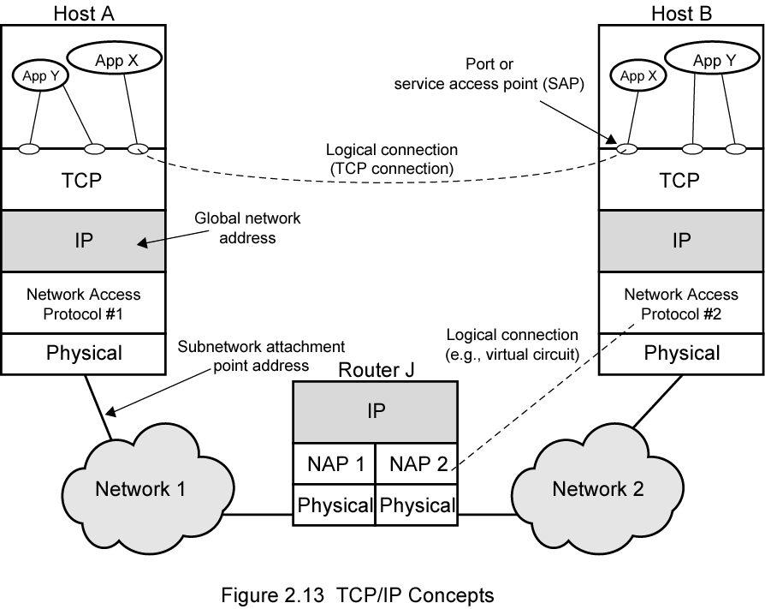
Operation of TCP and IP
Notes:
Stallings DCC8e Figure 2.1 indicates how these protocols are configured for communications. To make clear that the total communications facility may consist of multiple networks, the constituent networks are usually referred to as subnetworks. Some sort of network access protocol, such as the Ethernet logic, is used to connect a computer to a subnetwork. This protocol enables the host to send data across the subnetwork to another host or, if the target host is on another subnetwork, to a router that will forward the data. IP is implemented in all of the end systems and the routers. It acts as a relay to move a block of data from one host, through one or more routers, to another host. TCP is implemented only in the end systems; it keeps track of the blocks of data to assure that all are delivered reliably to the appropriate application.

Slide 16
Addressing Requirements
two levels of addressing required
each host on a subnet needs a unique global network address
  its IP address
each application on a (multi-tasking) host needs a unique address within the host
  known as a port
Notes:
For successful communication, every entity in the overall system must have a unique address. Actually, two levels of addressing are needed. Each host on a subnetwork must have a unique global internet address; this allows the data to be delivered to the proper host. Each process with a host must have an address that is unique within the host; this allows the host-to-host protocol (TCP) to deliver data to the proper process. These latter addresses are known as ports.

Slide 17
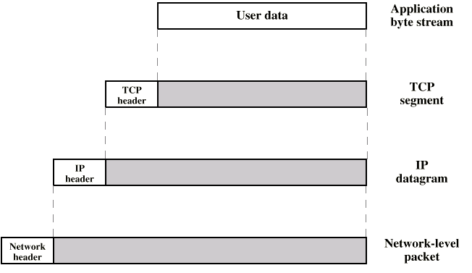
Operation of TCP/IP
Notes:
Consider a simple operation where a process on host A, wishes to send a message to another process on host B. The process at A hands the message down to TCP with instructions to send it to host B. TCP hands the message down to IP with instructions to send it to host B. Note that IP need not be told the identity of the destination port. Next, IP hands the message down to the network access layer (e.g., Ethernet logic) with instructions to send it to router J (the first hop on the way to B).
To control this operation, control information as well as user data must be transmitted, as suggested in Stallings DCC8e Figure 2.2. The sending process generates a block of data and passes this to TCP. TCP may break this block into smaller pieces to make it more manageable. To each of these pieces, TCP appends control information known as the TCP header, forming a TCP segment.
Next, TCP hands each segment over to IP, with instructions to transmit it to B. These segments must be transmitted across one or more subnetworks and relayed through one or more intermediate routers. This operation, too, requires the use of control information. Thus IP appends a header of control information to each segment to form an IP datagram.
Finally, each IP datagram is presented to the network access layer for transmission across the first subnetwork in its journey to the destination. The network access layer appends its own header, creating a packet, or frame. The packet is transmitted across the subnetwork to router J.

Slide 18
Transmission Control Protocol (TCP)
usual transport layer is TCP
provides a reliable connection for transfer of data between applications
a TCP segment is the basic protocol unit
TCP tracks segments between entities for duration of each connection
Notes:
For most applications running as part of the TCP/IP protocol architecture, the transport layer protocol is TCP. TCP provides a reliable connection for the transfer of data between applications. A connection is simply a temporary logical association between two entities in different systems. A logical connection refers to a given pair of port values. For the duration of the connection each entity keeps track of TCP segments coming and going to the other entity, in order to regulate the flow of segments and to recover from lost or damaged segments.

Slide 19
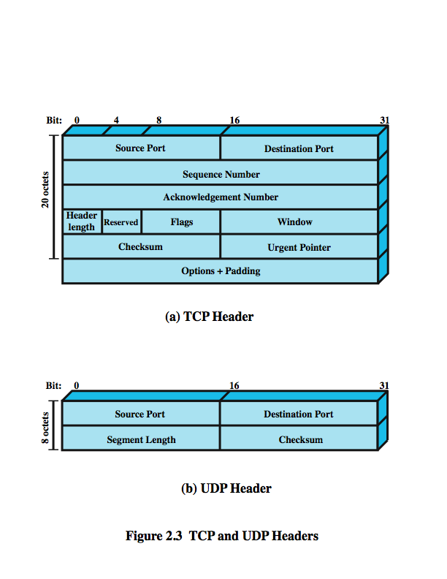
TCP Header
(skip details…)
Notes:
TCP segments include a header. Stallings DCC8e Figure 2.3a shows the header format for TCP, which is a minimum of 20 octets, or 160 bits. The Source Port and Destination Port fields identify the applications at the source and destination systems that are using this connection. The Sequence Number, Acknowledgment Number, and Window fields provide flow control and error control. The checksum is a 16-bit frame check sequence used to detect errors in the TCP segment. Chapter 20 provides more details.

Slide 20
User Datagram Protocol
(UDP)
an alternative to TCP
no guaranteed delivery
no preservation of sequence
no protection against duplication
minimum overhead
adds port addressing to IP
Notes:
In addition to TCP, there is one other transport-level protocol that is in common use as part of the TCP/IP protocol suite: the User Datagram Protocol (UDP). UDP does not guarantee delivery, preservation of sequence, or protection against duplication. UDP enables a procedure to send messages to other procedures with a minimum of protocol mechanism. Some transaction-oriented applications make use of UDP; eg SNMP (Simple Network Management Protocol). Because it is connectionless, UDP has very little to do. Essentially, it adds a port addressing capability to IP.

Slide 21
UDP Header
(skip details…)
Notes:
Because it is connectionless, UDP has very little to do. just adding a port addressing capability to IP. This is best seen by examining the UDP header, shown in Stallings DCC8e Figure 2.3b. The UDP header also includes a checksum to verify that no error occurs in the data; the use of the checksum is optional.

Slide 22
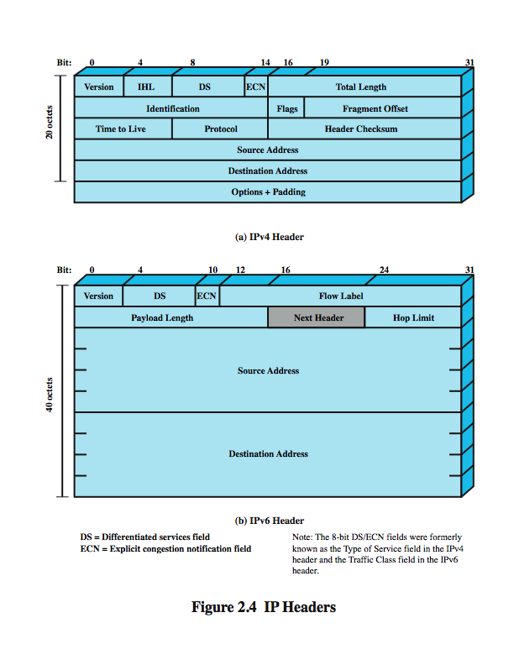
IP Header
(skip details…)
Notes:
For decades, the keystone of the TCP/IP protocol architecture has been IP. Stallings DCC8e Figure 2.4a shows the IP header format, which is a minimum of 20 octets, or 160 bits. The header, together with the segment from the transport layer, forms an IP-level PDU referred to as an IP datagram or an IP packet. The header includes 32-bit source and destination addresses. The Header Checksum field is used to detect errors in the header to avoid misdelivery. The Protocol field indicates which higher-layer protocol is using IP. The ID, Flags, and Fragment Offset fields are used in the fragmentation and reassembly process. Chapter 18 provides more detail.

Slide 23
IPv6
Provides enhancements over existing IP
Designed to accommodate higher speeds and the mix of graphic and video data
Driving force was the need for more addresses due to growth of the Internet
IPv6 includes 128-bit source and destination address fields
Notes:
IP and IPv6
For decades, the keystone of the TCP/IP protocol architecture has been IPv4, generally referred to simply as IP. Stallings DCC9e Figure 2.7a shows the IP header format, which is a minimum of 20 octets, or 160 bits. The header, together with the segment from the transport layer, forms an IP-level PDU referred to as an IP datagram or an IP packet. The header includes 32-bit source and destination addresses. The Header Checksum field is used to detect errors in the header to avoid misdelivery. The Protocol field indicates which higher-layer protocol is using IP. The ID, Flags, and Fragment Offset fields are used in the fragmentation and reassembly process. Chapter 18 provides more detail.
In 1995, the Internet Engineering Task Force (IETF), which develops protocol standards for the Internet, issued a specification for a next-generation IP, known then as IPng. This specification was turned into a standard in 1996 known as IPv6. IPv6 provides a number of functional enhancements over the existing IP, designed to accommodate the higher speeds of today's networks and the mix of data streams, including graphic and video, that are becoming more prevalent. But the driving force behind the development of the new protocol was the need for more addresses. IPv4 uses a 32-bit address to specify a source or destination. With the explosive growth of the Internet and of private networks attached to the Internet, this address length became insufficient to accommodate all systems needing addresses

Slide 24
IPv6 Header
(skip details…)
Notes:
In 1995, the Internet Engineering Task Force (IETF), which develops protocol standards for the Internet, issued a specification for a next-generation IP, known then as IPng. This specification was turned into a standard in 1996 known as IPv6. IPv6 provides a number of functional enhancements over the existing IP, designed to accommodate the higher speeds of today's networks and the mix of data streams, including graphic and video, that are becoming more prevalent. But the driving force behind the development of the new protocol was the need for more addresses. The current IP uses a 32-bit address to specify a source or destination. With the explosive growth of the Internet and of private networks attached to the Internet, this address length became insufficient to accommodate all systems needing addresses. As Stallings DCC8e Figure 2.4b shows, IPv6 includes 128-bit source and destination address fields. Ultimately, all installations using TCP/IP are expected to migrate from the current IP to IPv6, but this process will take many years, if not decades.

Slide 25
TCP/IP Applications
have a number of standard TCP/IP applications such as
  Simple Mail Transfer Protocol (SMTP)
  File Transfer Protocol (FTP)
  Telnet
Notes:
A number of applications have been standardized to operate on top of TCP. We mention three of the most common here.
The Simple Mail Transfer Protocol (SMTP) provides a basic electronic mail transport facility for transferring messages among separate hosts. The SMTP protocol does not specify the way in which messages are to be created; some local editing or native electronic mail facility is required. The target SMTP module will store the incoming message in a user's mailbox.
The File Transfer Protocol (FTP) is used to send files from one system to another under user command. Both text and binary files are accommodated. FTP sets up a TCP connection to the target system for the exchange of control messages. Once a file transfer is approved, a second TCP data connection is set up for the data transfer, without the overhead of any headers or control information at the application level. When the transfer is complete, the control connection is used to signal the completion and to accept new file transfer commands.
TELNET provides a remote logon capability, which enables a user at a terminal or personal computer to logon to a remote computer and function as if directly connected to that computer. The protocol was designed to work with simple scroll-mode terminals. Terminal traffic between User and Server TELNET is carried on a TCP connection.

Slide 26
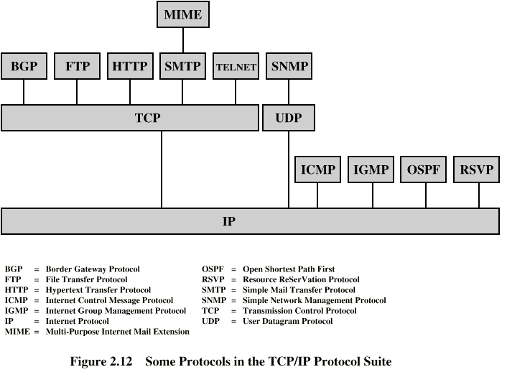
Some TCP/IP Protocols
Notes:
Each layer in the TCP/IP protocol suite interacts with its immediate adjacent layers. This use of each individual layer is not required by the architecture. As Stallings DCC8e Figure 2.5 suggests, it is possible to develop applications that directly invoke the services of any one of the layers. Most applications require a reliable end-to-end protocol and thus make use of TCP. Some special-purpose applications do not need the services of TCP. Some of these applications, such as the Simple Network Management Protocol (SNMP), use an alternative end-to-end protocol known as the User Datagram Protocol (UDP); others may make use of IP directly. Applications that do not involve internetworking and that do not need TCP have been developed to invoke the network access layer directly.

Slide 27
OSI
Open Systems Interconnection
  developed by the International Organization for Standardization (ISO)
  hence the « confusion » between ISO and OSI
has seven layers
is a theoretical system delivered too late!
TCP/IP is the “de facto” standard
Notes:
The Open Systems Interconnection (OSI) reference model was developed by the International Organization for Standardization (ISO - which is not an acronym but a word, derived from the Greek isos, meaning equal) as a model for a computer protocol architecture and as a framework for developing protocol standards. The OSI model consists of seven layers. The designers of OSI assumed that this model and the protocols developed within this model would come to dominate computer communications, eventually replacing proprietary protocol implementations and rival multivendor models such as TCP/IP. This has not happened. Although many useful protocols have been developed in the context of OSI, the overall seven-layer model has not flourished. Instead, the TCP/IP architecture has come to dominate.

Slide 28
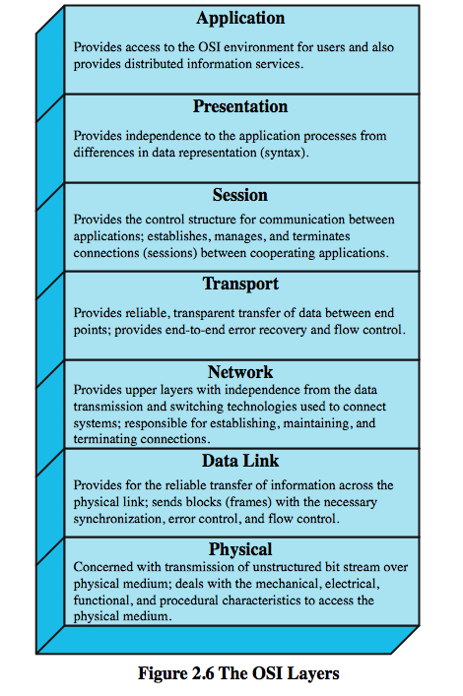
OSI Layers
Notes:
Stallings DCC8e Figure 2.6 illustrates the OSI model and provides a brief definition of the functions performed at each layer. The intent of the OSI model is that protocols be developed to perform the functions of each layer.

Slide 29
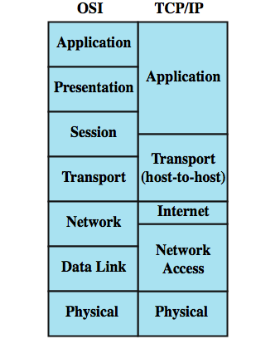
OSI vs TCP/IP
Notes:
There are a number of reasons why the TCP/IP architecture has come to dominate. Perhaps the most important is that the key TCP/IP protocols were mature and well tested at a time when similar OSI protocols were in the development stage. When businesses began to recognize the need for interoperability across networks, only TCP/IP was available and ready to go. Another reason is that the OSI model is unnecessarily complex, with seven layers to accomplish what TCP/IP does with fewer layers. Stallings DCC8e Figure 2.7 illustrates the layers of the TCP/IP and OSI architectures, showing roughly the correspondence in functionality between the two.

Slide 30
OSI vs Bluetooth
Figure :
http://ptgmedia.pearsoncmg.com/images/chap1_0130661066/elementLinks/01fig03.gif
Details (skip) :
http://www.informit.com/articles/article.aspx?p=27591&seqNum=5
Notes:
There are a number of reasons why the TCP/IP architecture has come to dominate. Perhaps the most important is that the key TCP/IP protocols were mature and well tested at a time when similar OSI protocols were in the development stage. When businesses began to recognize the need for interoperability across networks, only TCP/IP was available and ready to go. Another reason is that the OSI model is unnecessarily complex, with seven layers to accomplish what TCP/IP does with fewer layers. Stallings DCC8e Figure 2.7 illustrates the layers of the TCP/IP and OSI architectures, showing roughly the correspondence in functionality between the two.

Slide 31
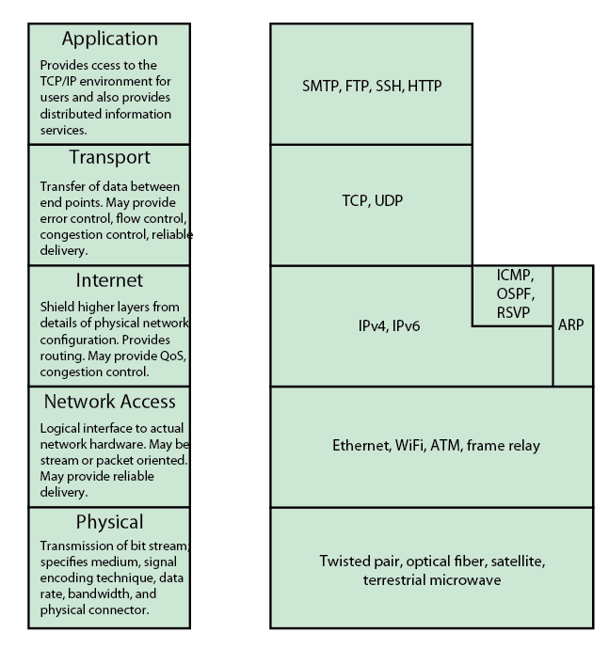
TCP/IP Layers and Example Protocols
Notes:
The TCP/IP Layers
In general terms, computer communications can be said to involve three agents: applications, computers, and networks. Examples of applications include file transfer and electronic mail. The applications that we are concerned with here are distributed applications that involve the exchange of data between two computer systems. These applications, and others, execute on computers that can often support multiple simultaneous applications. Computers are connected to networks, and the data to be exchanged are transferred by the network from one computer to another. Thus, the transfer of data from one application to another involves first getting the data to the computer in which the application resides and then getting the data to the intended application within the computer. With these concepts in mind, we can organize the communication task into five relatively independent layers (Stallings DCC9e Figure 2.3):
Physical layer
Network access layer
Internet layer
Host-to-host, or transport layer
Application layer

Slide 32
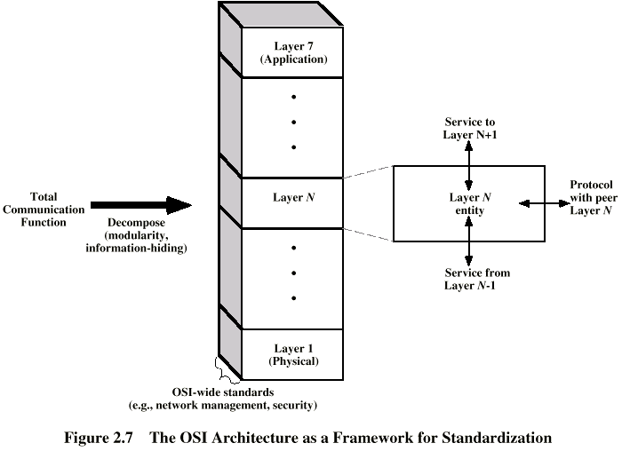
Standardized Protocol Architectures
Notes:
The principal motivation for the development of the OSI model was to provide a framework for standardization. Within the model, one or more protocol standards can be developed at each layer. The model defines in general terms the functions to be performed at that layer and facilitates the standards-making process in two ways by allowing standards to be developed independently and simultaneously for each layer, and because changes in standards in one layer need not affect already existing software in another layer.
Stallings DCC8e Figure 2.8 illustrates the use of the OSI model as such a framework. The overall communications function is decomposed into seven distinct layers, making the interfaces between modules as simple as possible. In addition, the design principle of information hiding is used: Lower layers are concerned with greater levels of detail; upper layers are independent of these details. Each layer provides services to the next higher layer and implements a protocol to the peer layer in other systems.

Slide 33
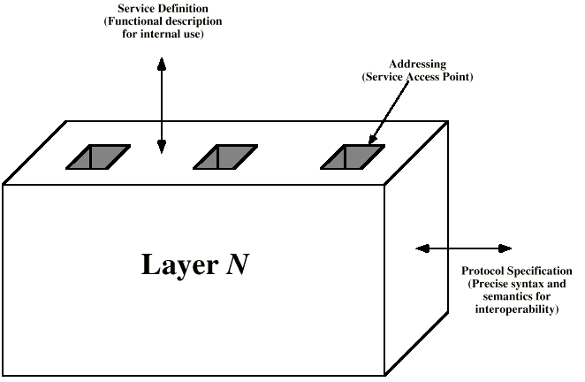
Layer Specific Standards
Notes:
Stallings DCC8e Figure 2.9 shows more specifically the nature of the standardization required at each layer. Three elements are key:
• Protocol specification: Two entities at the same layer in different systems cooperate and interact by means of a protocol. Because two different open systems are involved, the protocol must be specified precisely. This includes the format of the protocol data units exchanged, the semantics of all fields, and the allowable sequence of PDUs.
• Service definition: In addition to the protocol or protocols that operate at a given layer, standards are needed for the services that each layer provides to the next higher layer. Typically, the definition of services is equivalent to a functional description that defines what services are provided, but not how the services are to be provided.
• Addressing: Each layer provides services to entities at the next higher layer. These entities are referenced by means of a service access point (SAP). Thus, a network service access point (NSAP) indicates a transport entity that is a user of the network service.

Slide 34
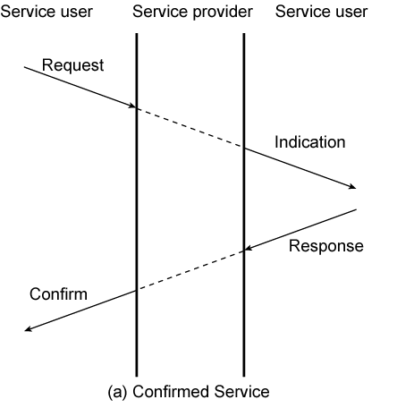
Service Primitives and Parameters
define services between adjacent layers using:
  primitives to specify function performed
  parameters to pass data and control info
Notes:
The services between adjacent layers in the OSI architecture are expressed in terms of primitives and parameters. A primitive specifies the function to be performed, and the parameters are used to pass data and control information. The actual form of a primitive is implementation dependent. An example is a procedure call. The layout of Stallings DCC8e Figure 2.10a suggests the time ordering of these events. For example, consider the transfer of data from an (N) entity to a peer (N) entity in another system. The following steps occur:
The source (N) entity invokes its (N –1) entity with a request primitive including needed parameters,such as the data to be transmitted and the destination address.
The source (N –1) entity prepares an (N –1) PDU to be sent to its peer (N –1) entity.
The destination (N –1) entity delivers the data to the appropriate destination (N) entity via an indication primitive, which includes the data and source address as parameters.
If an ack needed, destination (N) entity issues a response primitive to its (N –1) entity.
The (N –1) entity conveys the acknowledgment in an (N –1) PDU.
The acknowledgment is delivered to the (N) entity as a confirm primitive.
This sequence of events is referred to as a confirmed service, as the initiator receives confirmation that the requested service has had the desired effect at the other end.

Slide 35
Primitive Types
REQUEST | A primitive issued by a service user to invoke some service and to pass the parameters needed to specify fully the requested service
INDICATION | A primitive issued by a service provider either to: indicate that a procedure has been invoked by the peer service user on the connection and to provide the associated parameters, or notify the service user of a provider-initiated action
RESPONSE | A primitive issued by a service user to acknowledge or complete some procedure previously invoked by an indication to that user
CONFIRM | A primitive issued by a service provider to acknowledge or complete some procedure previously invoked by a request by the service user
Notes:
Stallings DCC8e Table 2.1 defines the four types of primitives are used in standards to define the interaction between adjacent layers in the architecture (X.210)

Slide 36
Traditional vs Multimedia Applications
Traditionally, Internet dominated by info retrieval applications
  typically using text and image transfer
  eg. email, file transfer, web
see increasing growth in multimedia applications
  involving massive amounts of data
  such as streaming audio and video
Notes:
The Internet, until recently, has been dominated by information retrieval applications, e-mail, and file transfer, plus Web interfaces that emphasized text and images. Increasingly, the Internet is being used for multimedia applications that involve massive amounts of data for visualization and support of real-time interactivity. Streaming audio and video are perhaps the best known of such applications.
Although traditionally the term multimedia has connoted the simultaneous use of multiple media types (e.g., video annotation of a text document), the term has also come to refer to applications that require real-time processing or communication of video or audio alone. Thus, voice over IP (VoIP), streaming audio, and streaming video are considered multimedia applications even though each involves a single media type.

Slide 37
Domains of Multimedia Systems and Example Applications
Traffic report : Google maps + GPS (on Android phones)
- poses some ethics issues…
Apple TV : Music and video streaming from iPhones and iPads
Chrome Cast
Notes:
The Internet, until recently, has been dominated by information retrieval applications, e-mail, and file transfer, plus Web interfaces that emphasized text and images. Increasingly, the Internet is being used for multimedia applications that involve massive amounts of data for visualization and support of real-time interactivity. Streaming audio and video are perhaps the best known of such applications. An example of an interactive application is a virtual training environment involving distributed simulations and real-time user interaction [VIN98]. Some other examples are shown in Stallings DCC9e Table 2.3.

Slide 38
Elastic and Inelastic Traffic
elastic traffic
  can adjust to delay & throughput changes over a wide range
  eg. traditional “data” style TCP/IP traffic
  some applications are more sensitive though
inelastic traffic
  does not adapt to such changes
  eg. “real-time” voice & video traffic
  need minimum requirements on network architecture
Notes:
Traffic on a network or internet can be divided into two broad categories: elastic and inelastic. Elastic traffic can adjust, over wide ranges, to changes in delay and throughput across an internet and still meet the needs of its applications. This is the traditional type of traffic supported on TCP/IP-based internets and is the type of traffic for which internets were designed. Elastic applications include common Internet-based applications, such as file transfer, electronic mail, remote logon, network management, and Web access. But there are differences among the requirements of these applications.
Inelastic traffic does not easily adapt, if at all, to changes in delay and throughput across an internet. The prime example is real-time traffic, such as voice and video. The requirements for inelastic traffic may include the following: minimum throughput may be required, may be delay-sensitive, may require a reasonable upper bound on delay variation, may vary in the amount of packet loss, if any, that they can sustain.
These requirements are difficult to meet in an environment with variable queuing delays and congestion losses. Accordingly, inelastic traffic introduces two new requirements into the internet architecture.

Slide 39
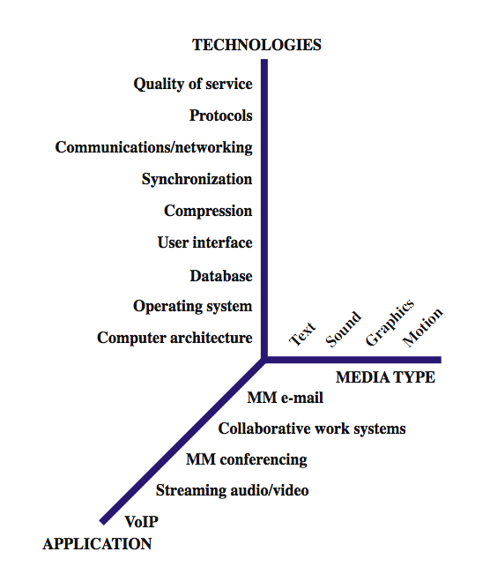
(Multimedia Technologies)
Notes:
Stallings DCC8e Figure 2.11 looks at multimedia from the perspective of three different dimensions: type of media, applications, and the technology required to support the applications. Consider the list of technologies relevant to the support of multimedia applications. As can be seen, a wide range is involved. The lowest four items on the list are beyond the scope of this book. The other items represent only a partial list of communications and networking technologies for multimedia. These technologies and others are explored throughout the book.

Slide 40
Summary
introduced need for protocol architecture
TCP/IP protocol architecture
OSI Model & protocol architecture standardization
traditional vs multimedia application needs
Notes:
Stallings DCC8e Chapter 2 summary.

